Slide 1
Phil Smith
28th November 2012
Design Patterns

Slide 2

Design Patterns
There are many ways to produce content via Servlets and JSPs
Understanding the good, the bad (and the ugly) is important.

Slide 3
Why should we use design patterns?
Reduces Development Time
Reduced Maintenance Time
Collaboration
Importance grows with the size of a project
Rebuilding an app is never desirable
Good design ensures an app should never need a complete overhaul

Slide 4
Common Design Patterns
Numerous ways to classify design patterns
Concepts important, not names
Design patterns do not date like code
Important to logically separate an app's functionality

Slide 5
Model 1
Concept: Code functionality wherever the functionality is needed
Simple
Instant Gratification
Need security? Code it in.
Need to access a DB? Code it in.
Relies on a request going to one resource, and the resource returning the correct reply

Slide 6
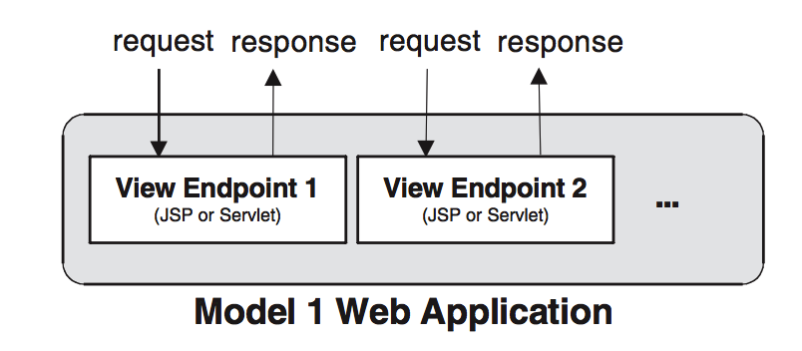
Illustration of Model 1 Architecture

Slide 7
Index.jsp
Responsible for displaying all current news
No forms
Scripting elements present
These are used to load and read information about current news
News is saved in an XML file, news.xml

Slide 8
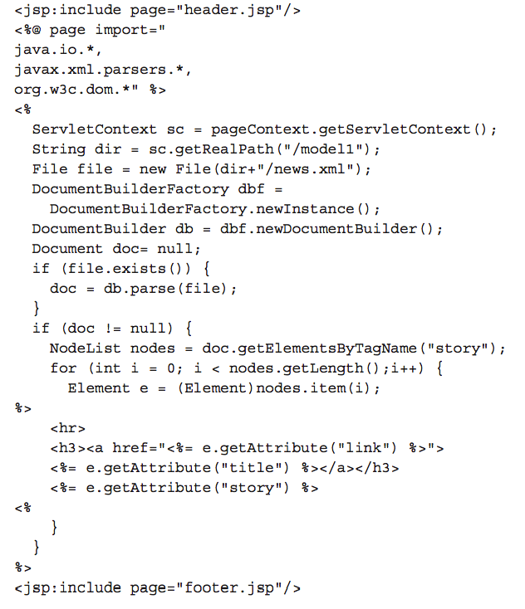
index.jsp

Slide 9
Addnews.jsp
Includes scripting elements
Method to solicit information from user
HTML form

Slide 10
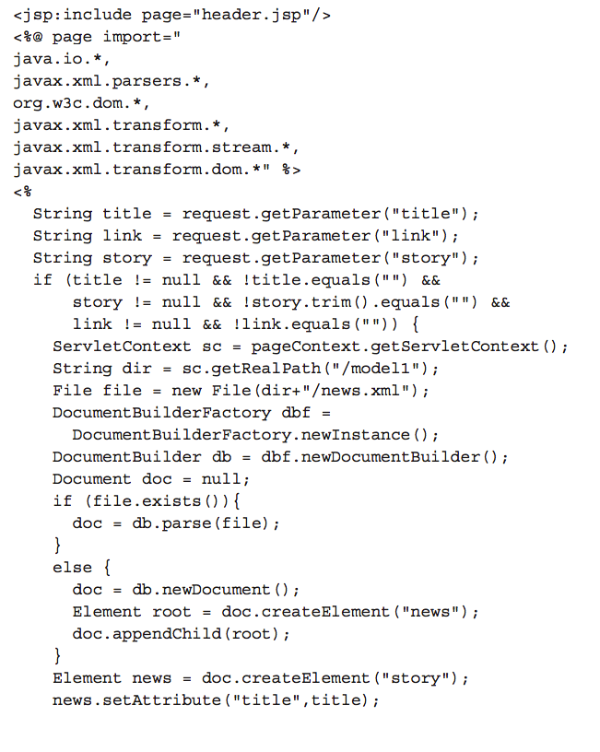
Addnews.jsp

Slide 11
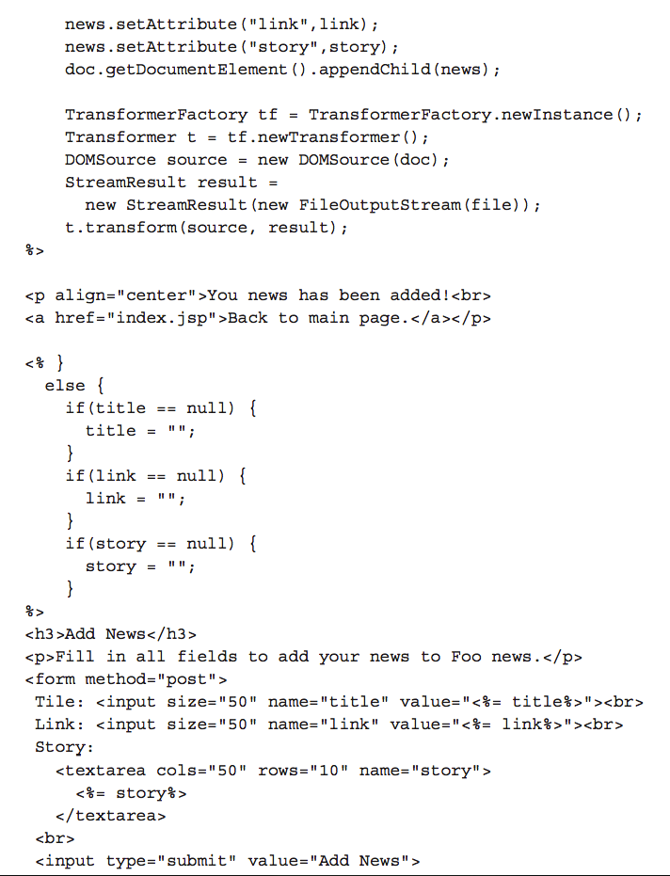

Slide 12
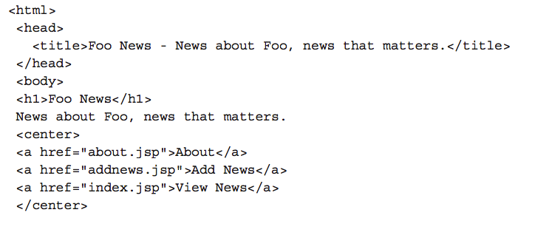
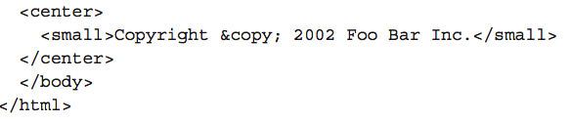
Header.jsp

Slide 13
Why is this Model 1?
Each request being mapped to a single endpoint
The endpoint is solely responsible for generating the final response
This application directly follows this rule
Each request URL goes to exactly one resource in the app.
All the response-generating logic is in the same resource

Slide 14
3 General Types of Page
Static page
  Easily authored in HTML
  Page doesn't change
Dynamic page
  Relies on server-side functionality provided by Servlets and JSP
Dynamic form page
  Requires user participation
  Usually through HTML form

Slide 15
Types of page
Static pages are used in all design patterns
They are easy to author
Dynamic pages are where different design patterns are important
Where the logic is placed can impact the ease of use

Slide 16
Model 1 Weaknesses
No great strengths
Used for trivial apps
Can be used by inexperienced developers
Design limits development of dynamic pages
Makes dynamic pages overly complex and cryptic
Difficult to maintain; hard to edit
Dynamic code alongside formatting

Slide 17
Weaknesses contd.
Index.jsp and Addnews.jsp hard to understand
Scripting elements especially
Java developers allowed to haphazardly embed code where they please
No separation of data access code and response generating code
Addnews.jsp should be two separate pages
Separated by conditional statement

Slide 18
Weaknesses contd.
Combining pages is a bad idea
Turns simple pages into one complex one
Code harder to manage
Attempts to modify code may break it
Combined pages are common to Model 1
Especially when forms are involved
Validation of forms
Flaws due to JSP scripting elements

Slide 19
Model 2
Also called Model View Control (MVC)
Seeks to solve problems of Model 1
Best method of implementing apps using Servlets and JSP
Popuplarized by Struts Framework
Separates business logic from presentation logic

Slide 20
Logic
Business Logic
  Consists of everything required to get needed runtime information
Presentation logic
  Consists of everything needed to format the information into a form a client expects
Separation keeps both parts simple
Both are more easily manipulated

Slide 21
MVC
Model
  Representation of the app's data repository
  Code involved with reading, writing and validation
View
  Interacts with user
Control
  Links the previous two components
  Responsible for providing proper view to user
  Keeps Model current

Slide 22
Implementation of Model 2
View
  Solely done via JSP
Model
  Encapsulated as a set of JavaBeans
  Manipulated with JSP
Control
  Servlet or Filter

Slide 23
JavaBean
Is a standard class for holding data:
  All its fields are private
  Fields are only accessible through getter and setter methods
  It has a constructore that takes no arguments
  It is Serializable

Slide 24
Filter
Performs filtering tasks on either:
  A servlet's request
  A servlet's response
  Both
Filtering performed through the doFilter method
Used for:
  Authentication
  Logging
  Image conversion
  Data compression
  Encryption

Slide 25
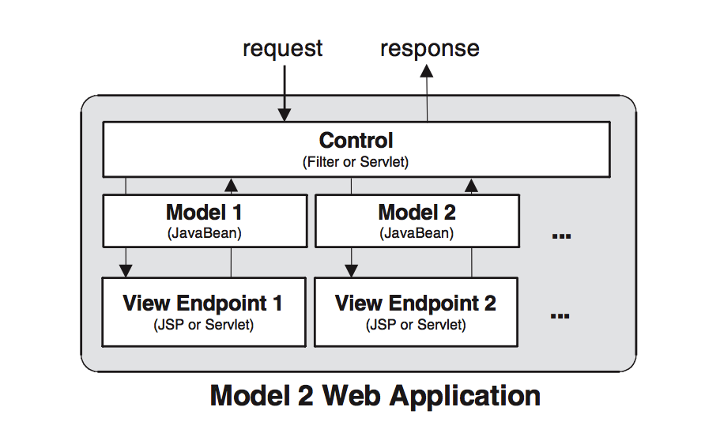
Model 2 Architecture

Slide 26
Important Concepts
Everything is cleanly separated
Layers the different types of functionality
Interfaces that the different parts of the design use to communicate
JavaBeans used by the view
Implementation of Control component
  Servlet accepts all requests and responses
  Very convenient to implement security, logging

Slide 27
Rebuilding the news site
New classes
  Filter is used as the Control component
  A Java bean is required to communicate with the JSP View pages
Filter is designed to intercept all request
Also executes implicit Java classes that are assumed to contain Model 2 logic

Slide 28
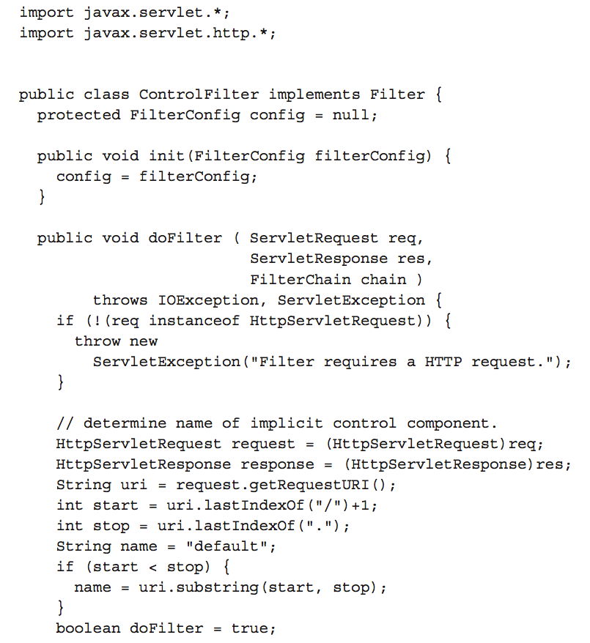
ControlFilter.java

Slide 29
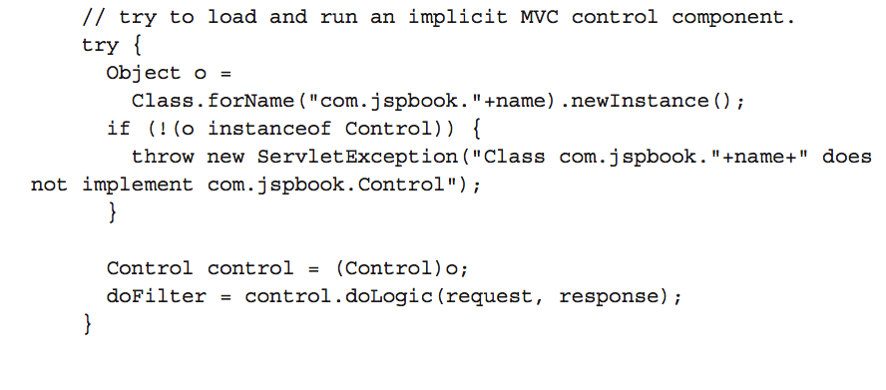
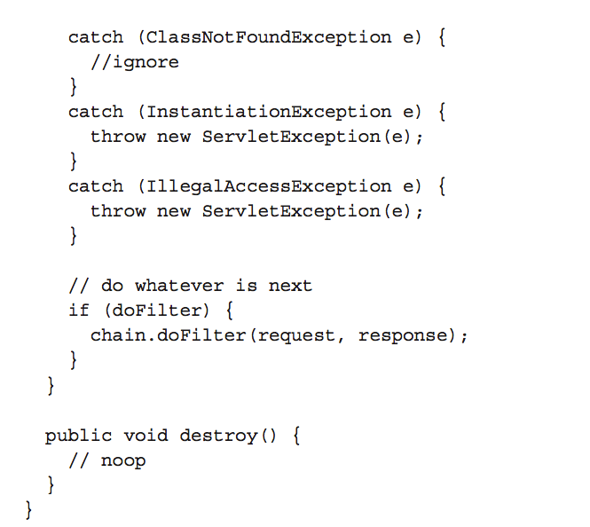

Slide 30
ControlFilter.java
If index.jsp is requested, Filter checks to see if it exists
If so, ControlFilter has a chance to process the request and response before index.jsp
However, Java objects are not inherently designed to do this
So, we need an interface.

Slide 31
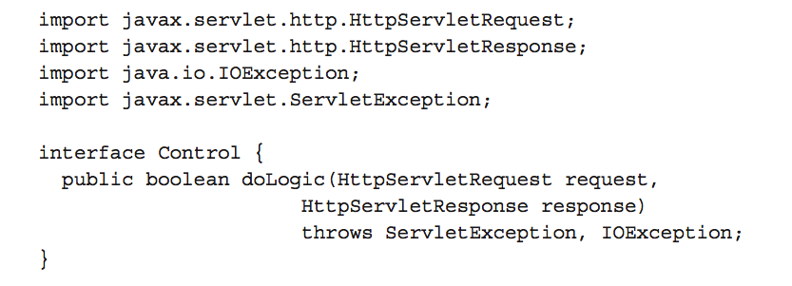
Control.java

Slide 32
Model 1 to Model 2
We must attempt to remove all scripts
Script's logic needs to be built into a logic component for use with the Control Filter
Index.jsp is the web page
Index.java is it's implicit logic component

Slide 33
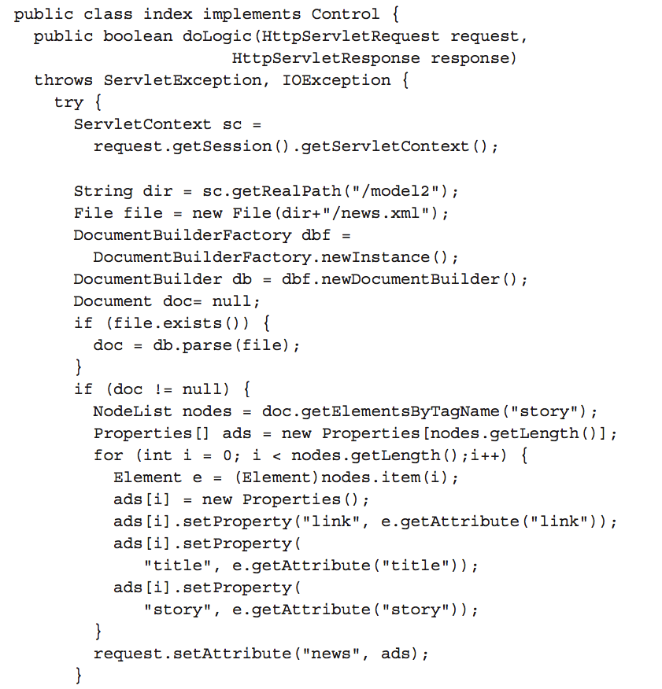
Index.java

Slide 34
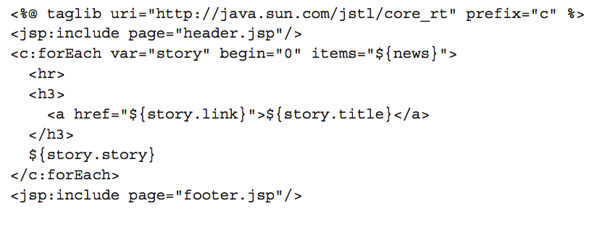
Index.jsp using JSTL

Slide 35
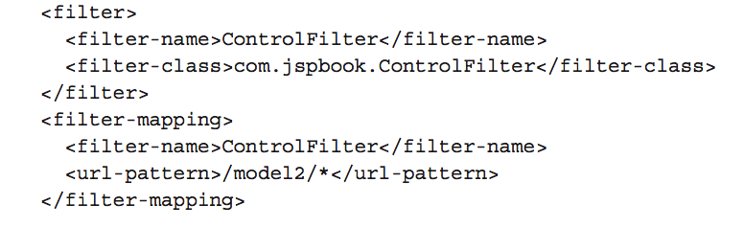
Web.xml for Control Filter

Slide 36
Why is this Model 2?
Enforcement of separation of business logic from presentation
Filter acts as controller
When request received, Filter initializes an appropriate model
  Then forwards control to the view
View JSP extracts data from the model
  Uses it to create the presentation data, the HTML

Slide 37
Why is this Model 2?
At no point is business logic mixed with presentation
No scripting elements
No HTML produced by Filter
View contains only HTML markup and dynamic data
Model and Control abstract out all code responsible for generation of dynamic data

Slide 38
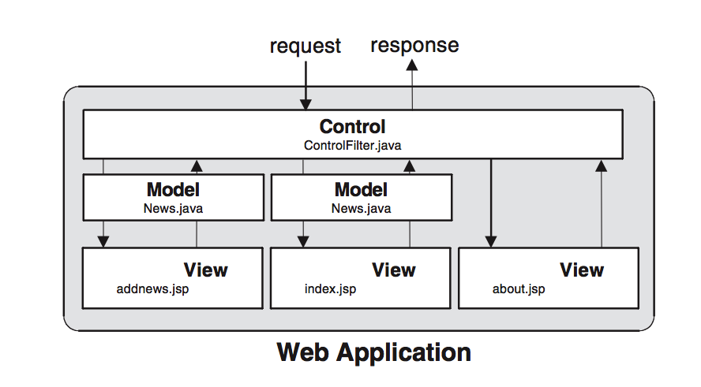
Model 2 Strengths
Clean separation of business logic and presentation
Pages are clean and elegant
Maintenance is simple

Slide 39
Model 2 Strengths
View has no idea where information comes from, but it does not matter
It could be a database, flat file or anything else.
Underlying data can be freely changed, depending on the contents of the Servlet
There is a good level of abstraction between the View and Model
This is as long as the request-scope variables between the two are correctly used

Slide 40
Model 2 Strengths
Control perfect to manipulate all requests and responses
Convenient for security, logging and error handling
OO-programming concepts that Java is built upon

Slide 41
Model 2 Weaknesses
None!

